Slide 1
HOUSE PRICE PREDICTION
Project 4

Slide 2

HOUSING PRICE PREDICTION OF MELBOURNE USING MACHINE LEARNING
Project Introduction
Challenges in Property Market Decision-Making
Advantages of Machine Learning
Project Goal
Project Objective
For Families : match their budget and preferences
For Investors : profitable investment opportunities
Data Source
https://www.kaggle.com/datasets/anthonypino/melbourne-housing-market
Data from 2016 - 2018

Slide 3







TECHNOLOGIES USED
Python/Pandas/Numpy
Jupyter Notebook
SciPy
Scikit-learn
Flask
HTML/CSS
JavaScript

Slide 4
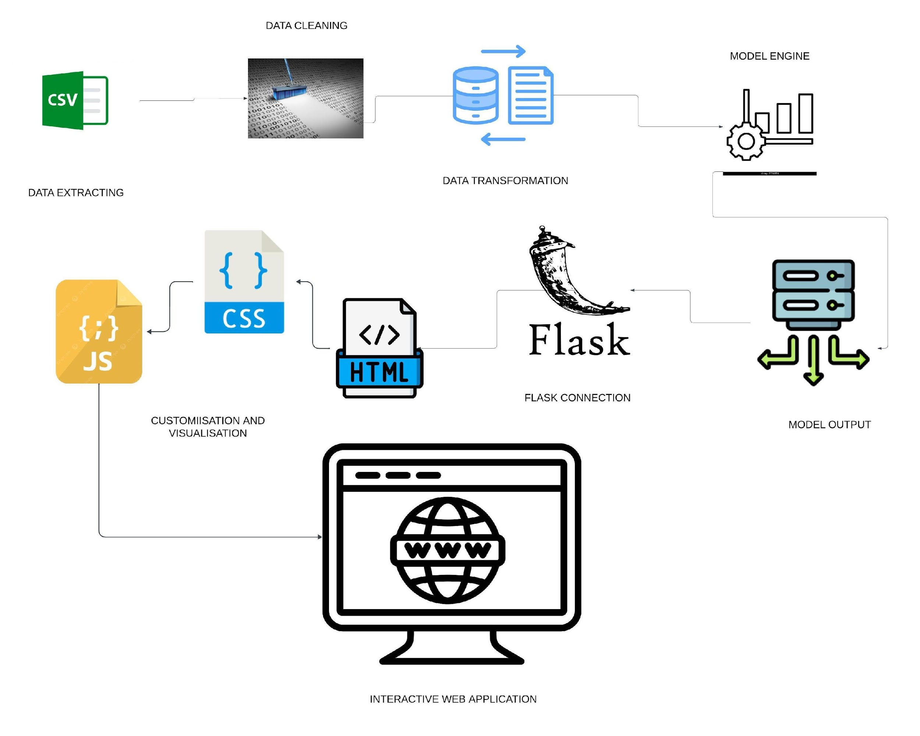

ETL PROCESS

Slide 5
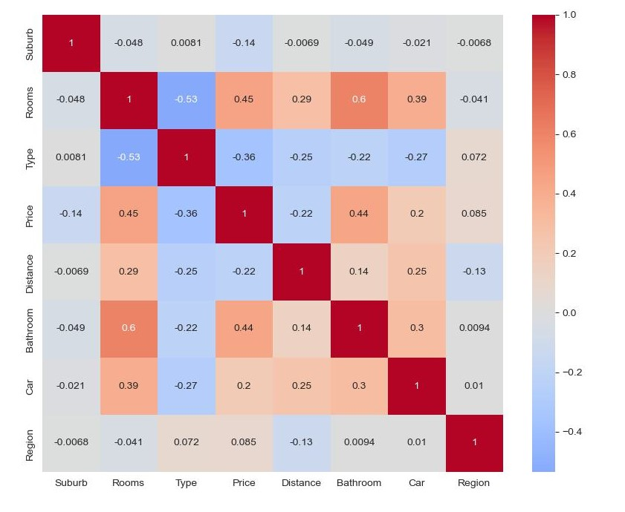
HEAT MAP
Heat Map used for features correlation

Slide 6
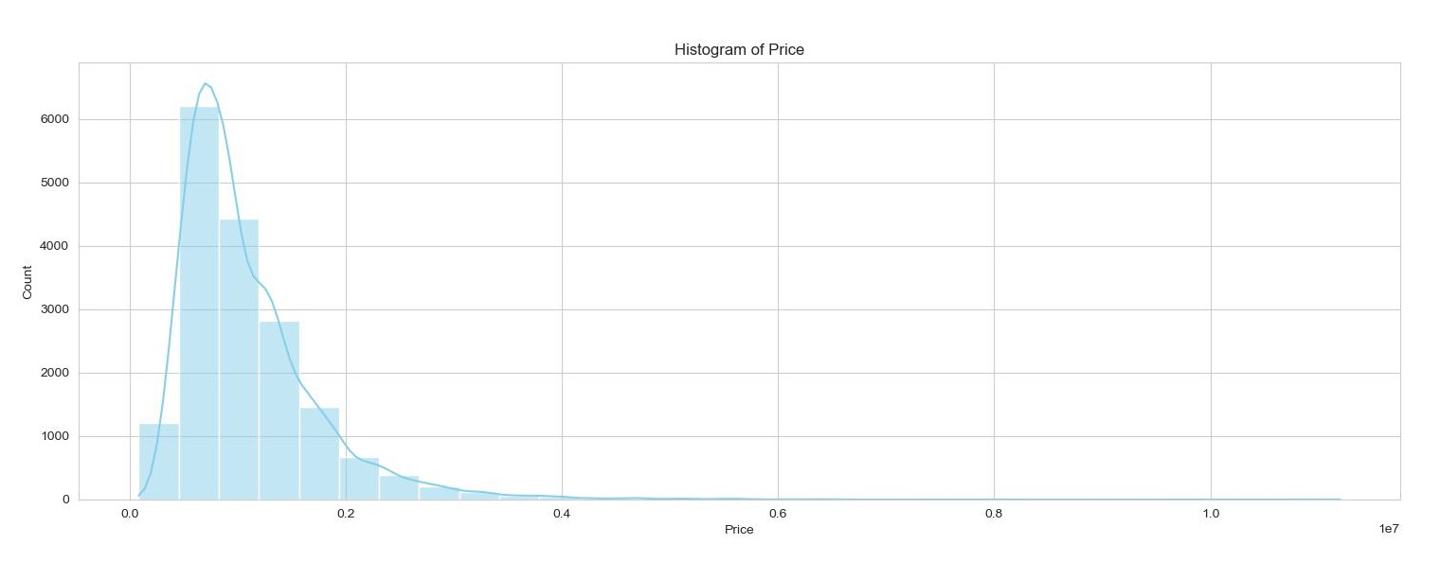
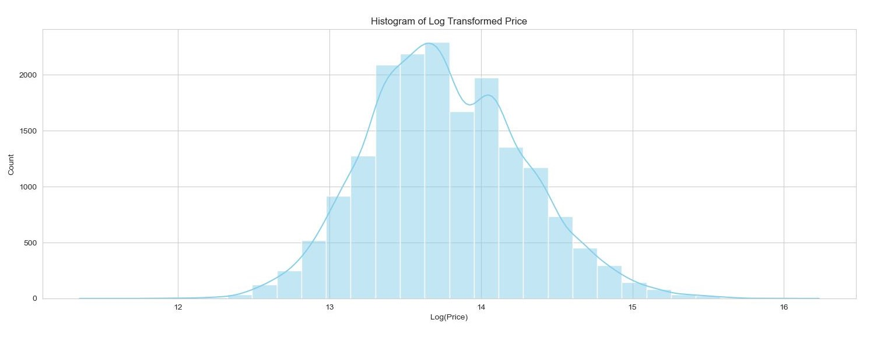
NORMALITY CHECK
CUSTOMERS
25% increase of buildings that are energy efficient proves that there's consumer interest for more green building design

Slide 7
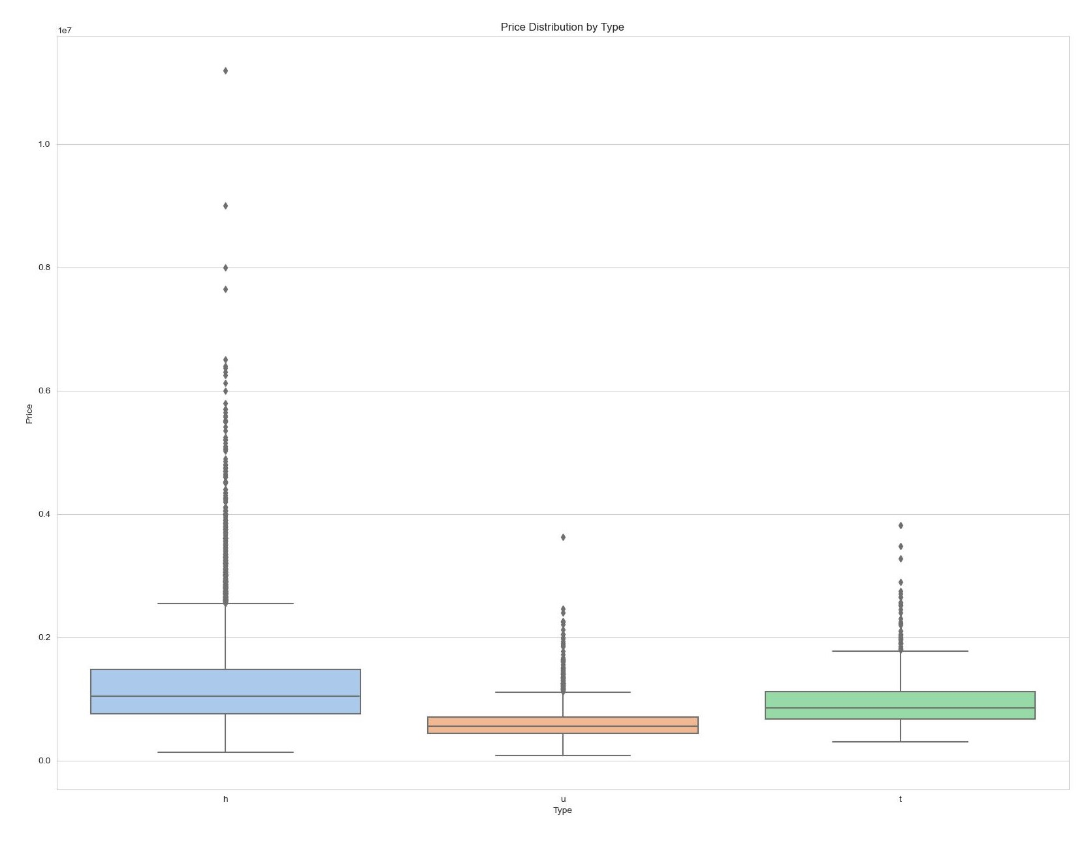
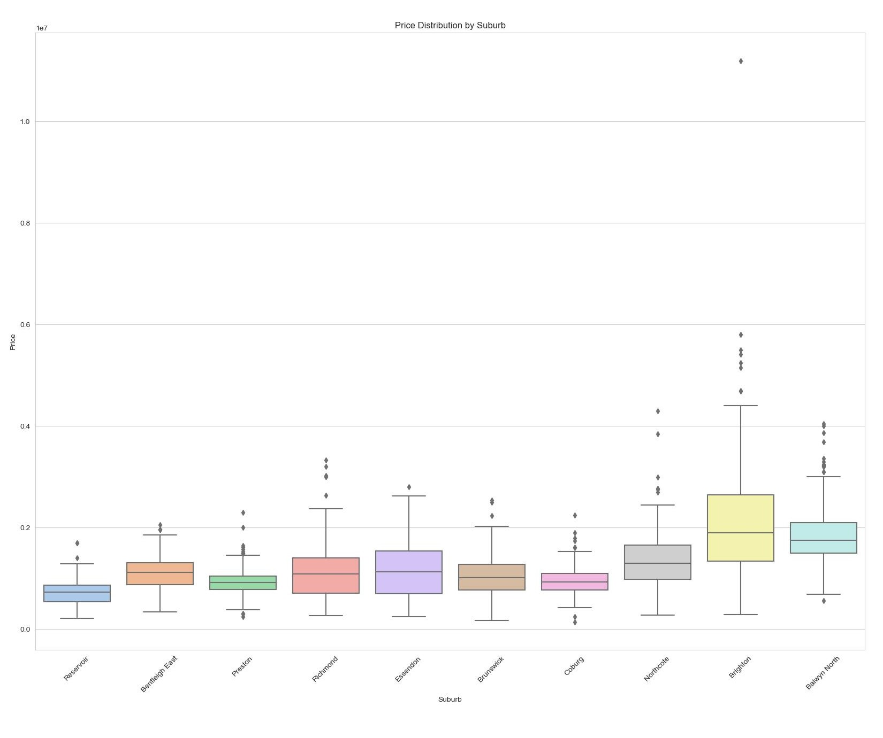
DATA VISUALIZATION

Slide 8
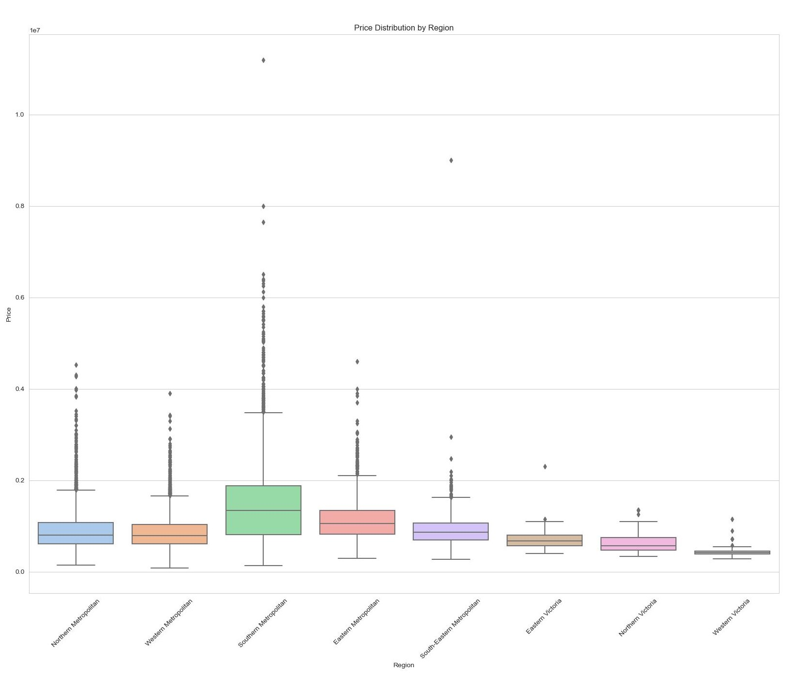
DATA VISUALIZATION

Slide 9
MODEL ANALYSIS
Linear Regression Model
Decision Tree Regression Model
Gradient Boosting Regression Model
Random Forest Regression Model
Support Vector Regressor Model
Lasso Model
Ridge Model
Randomized Search CV

Slide 10
MODELS TESTED
 | Train Score | Test Score
Linear Regression | 0.539060 | 0.518700
Gradient Boosting Model | 0.796061 | 0.774109
Random Forest | 0.911494 | 0.789304
Tuned Random Forest | 0.883882 | 0.801776
Decision Tree Model | 0.922393 | 0.737253
Tuned Decision Tree | 0.846100 | 0.779728
Support Vector | 0.785861 | 0.753859
Lasso Model | 0.0 | -2.194192
Ridge Model | 0.539060 | 0.518702

Slide 11

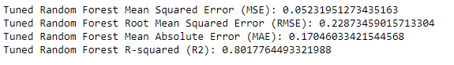

MODEL SCREENSHOT

Slide 12
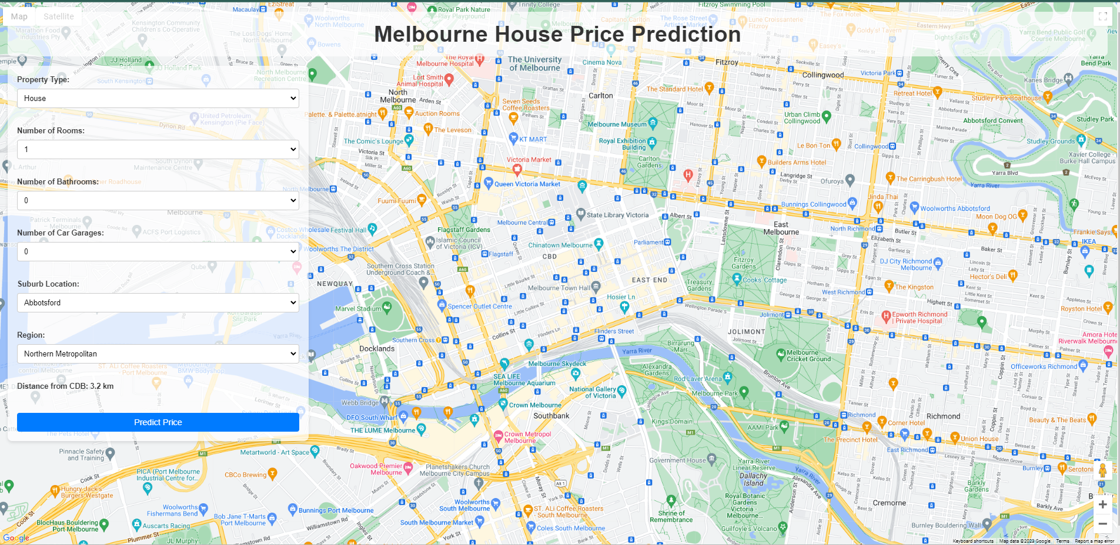
WEBSITE

Slide 13
CONCLUSION

Slide 14
THANK YOU
Akbar Fadillah
Jorge Chicas
Raviska
Sameer Hooda

